Slide 1
Ingredient Structures for Liquid Formulations Dataset

Slide 2
Surfactants
Anionic

Slide 3
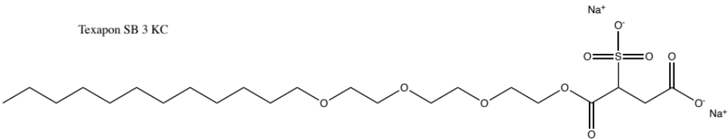
1. Texapon® SB 3 KC
INCI name(s): Disodium Laureth Sulfosuccinate
CCCCCCCCCCCCOCCOCCOCCOC(=O)C(CC(=O)[O-])S(=O)(=O)[O-].[Na+].[Na+]

Slide 4
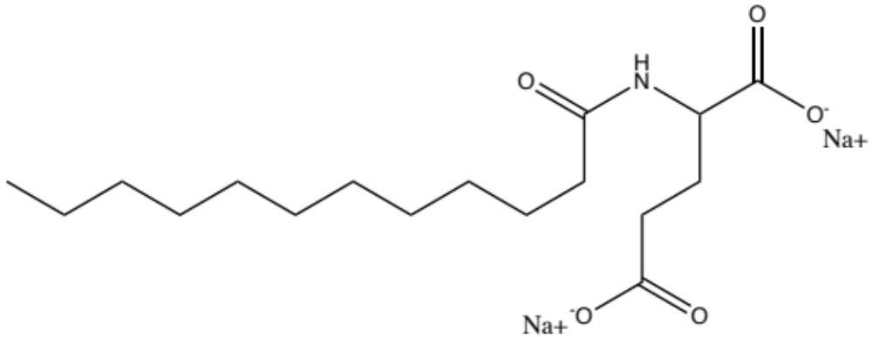
2. Plantapon® ACG 50
INCI name(s): Disodium Cocoyl Glutamate
CCCCCCCCCCCC(=O)NC(CCC(=O)[O-])C(=O)[O-].[Na+].[Na+]

Slide 5
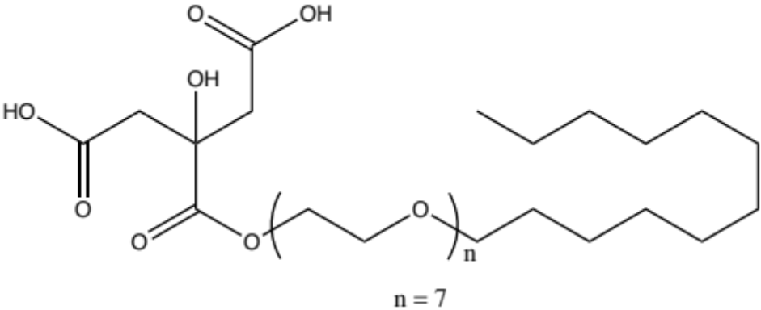
3. Plantapon® LC7
INCI name(s): Laureth-7 Citrate
OC(CC(O)(CC(O)=O)C(OCCOCCOCCOCCOCCOCCOCCOCCCCCCCCCCCC)=O)=O

Slide 6
Surfactants
Non-ionic

Slide 7
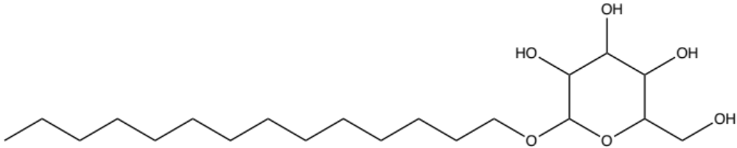
4. Plantacare® 818
INCI name(s): Coco-Glucoside
CCCCCCCCCCCCCCOC1OC(CO)C(O)C(O)C1O

Slide 8
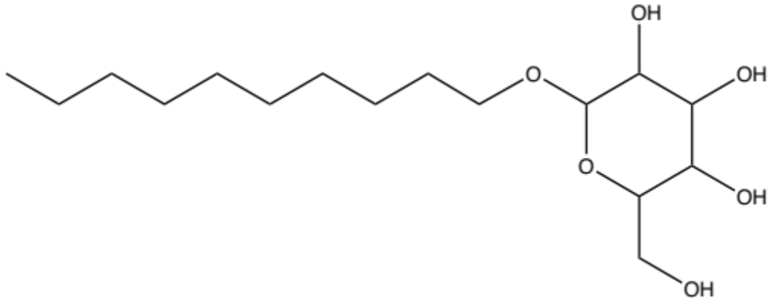
5. Plantacare® 2000
INCI name(s): Decyl-Glucoside
CCCCCCCCCCOC1OC(CO)C(O)C(O)C1O

Slide 9
Surfactants
Amphoteric

Slide 10
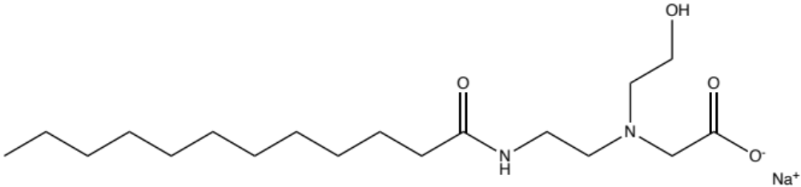
6. Dehyton® MC
INCI name(s): Sodium Cocoamphoacetate
CCCCCCCCCCCC(=O)NCCN(CCO)CC(=O)[O-].[Na+]

Slide 11
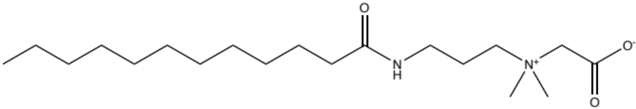
7. Dehyton® PK 45
INCI name(s): Cocamidopropyl Betaine
CCCCCCCCCCCC(NCCC[N+](C)(C)CC([O-])=O)=O

Slide 12
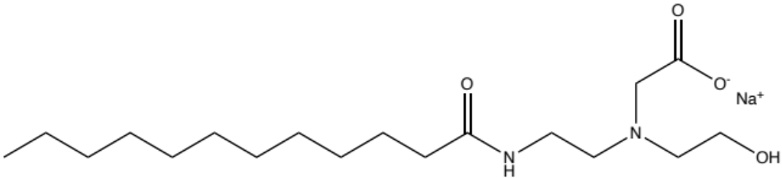
8. Dehyton® ML
INCI name(s): Sodium Lauroamphoacetate
CCCCCCCCCCCC(NCCN(CC([O-])=O)CCO)=O.[Na+]

Slide 13
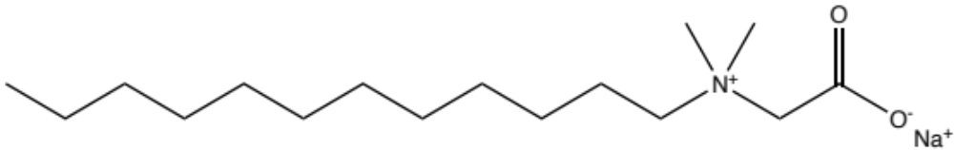
9. Dehyton® AB 30
INCI name(s): Coco-Betaine
CCCCCCCCCCCC[N+](C)(C)CC([O-])=O.[Na+]

Slide 14
Surfactants
Amino-acid based

Slide 15
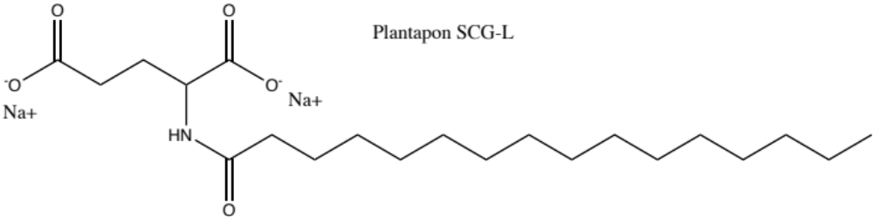
10. Plantapon® Amino SCG-L
INCI name(s): Sodium Cocoyl Glutamate
[O-]C(CCC(NC(CCCCCCCCCCCCCCC)=O)C([O-])=O)=O.[Na+].[Na+]

Slide 16
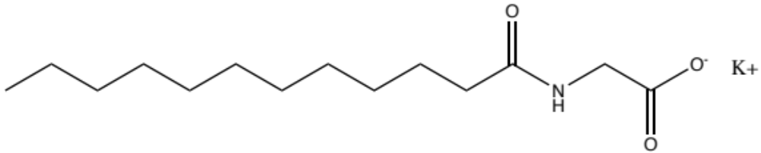
11. Plantapon® Amino KG-L
INCI name(s): Potassium Cocoyl Glycinate
CCCCCCCCCCCC(NCC([O-])=O)=O.[K+]

Slide 17
Surfactants
Cationic

Slide 18
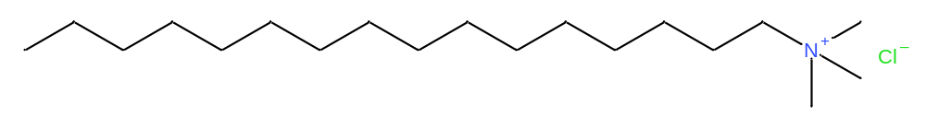
12. Dehyquart® A-CA
INCI name(s): Potassium Cetrimonium Chloride
CCCCCCCCCCCCCCCC[N+](C)(C)C.[Cl-]

Slide 19
Conditioning Polymers

Slide 20
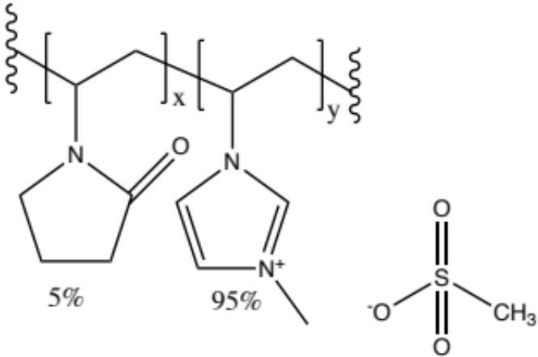
1. Luviquat® Excellence
INCI name(s): Polyquaternium-16
Chemical Description: Random copolymers of vinylpyrrolidone (VP) and quaternized vinylimidazole (QVI) with a range of charge densities, in aqueous solution
MW approx. 40000 g/mol

Slide 21
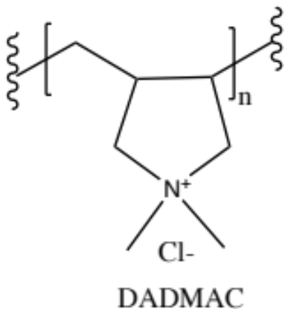
2. Dehyquart® CC6
INCI name(s): Polyquaternium-6
Chemical Description: Cationic aqueous solution of a diallyl dimethyl ammonium chloride homopolymer
MW: Unknown

Slide 22
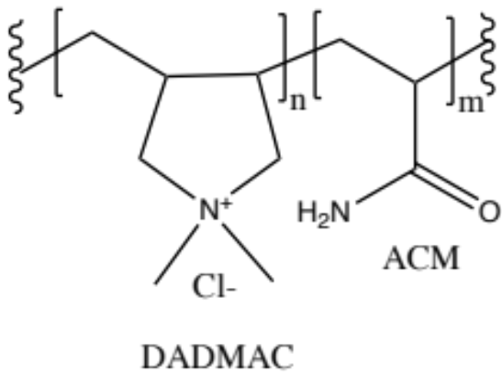
3. Dehyquart® CC7 BZ
INCI name(s): Polyquaternium-7
Chemical Description: Aqueous Solution of a cationic Diallyl Dimethyl Ammonium Chloride/Acrylamide random copolymer
MW: approx. 500,000 g/mol
54%
46%

Slide 23
4. Salcare® Super 7
INCI name(s): Polyquaternium-7
Chemical Description: Random copolymer of Acrylamide and Diallyl Dimethyl Ammonium Chloride
MW: 100,000 – 200,000 g/mol
75%
25%

Slide 24
Thickeners

Slide 25
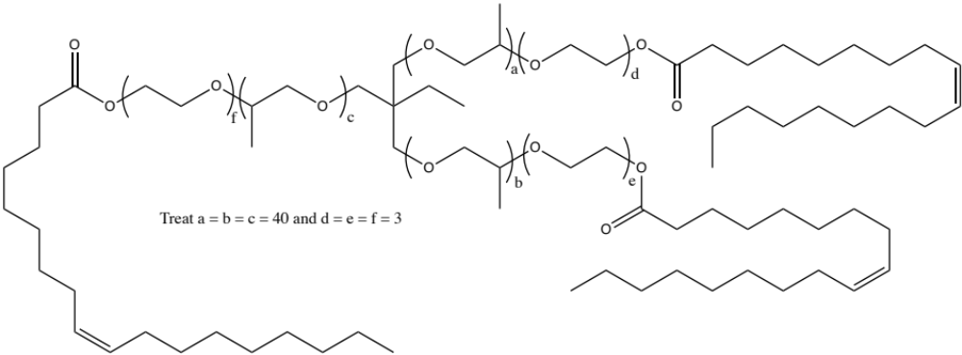
1. Arlypon® TT
INCI: PEG/PPG-120/10 Trimethylolpropane Trioeate (40-50%) (and) Laureth-2 (40-50%)
Since a-f is almost fixed, the MW can be calculated as 8295.

Slide 26
2. Arlypon® F
INCI name: Laureth-2
MW 302 g/mol
CCCCCCCCCCCCCCOCCOCCO

